Slide 1
Mood Board
Noah Stachera

Slide 2
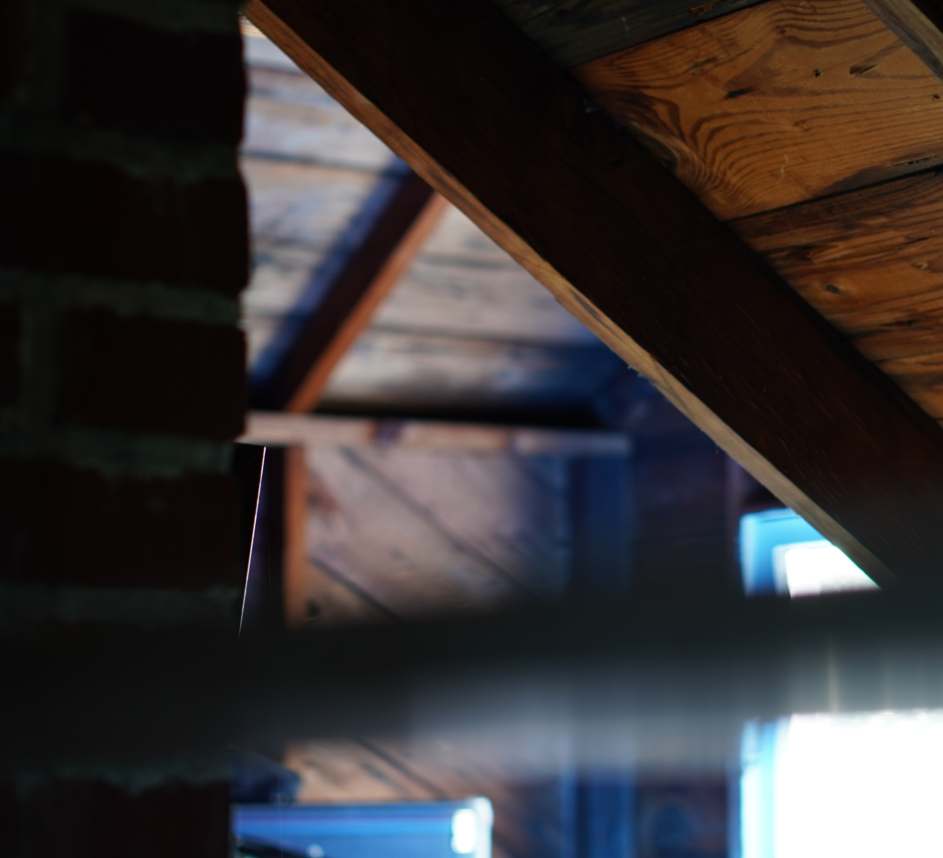
Setting
Most of the video is going to take place in a house or some small caved in area to simulate the idea that someone can’t get out even though they want to leave. The world around him or the things he interacts with, the people that he wants to detach from in his life, are in this enclosed location.

Slide 3
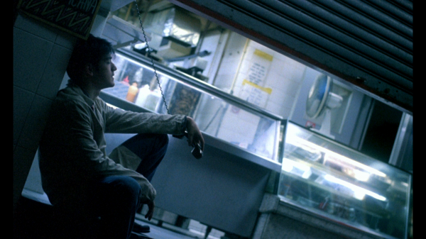
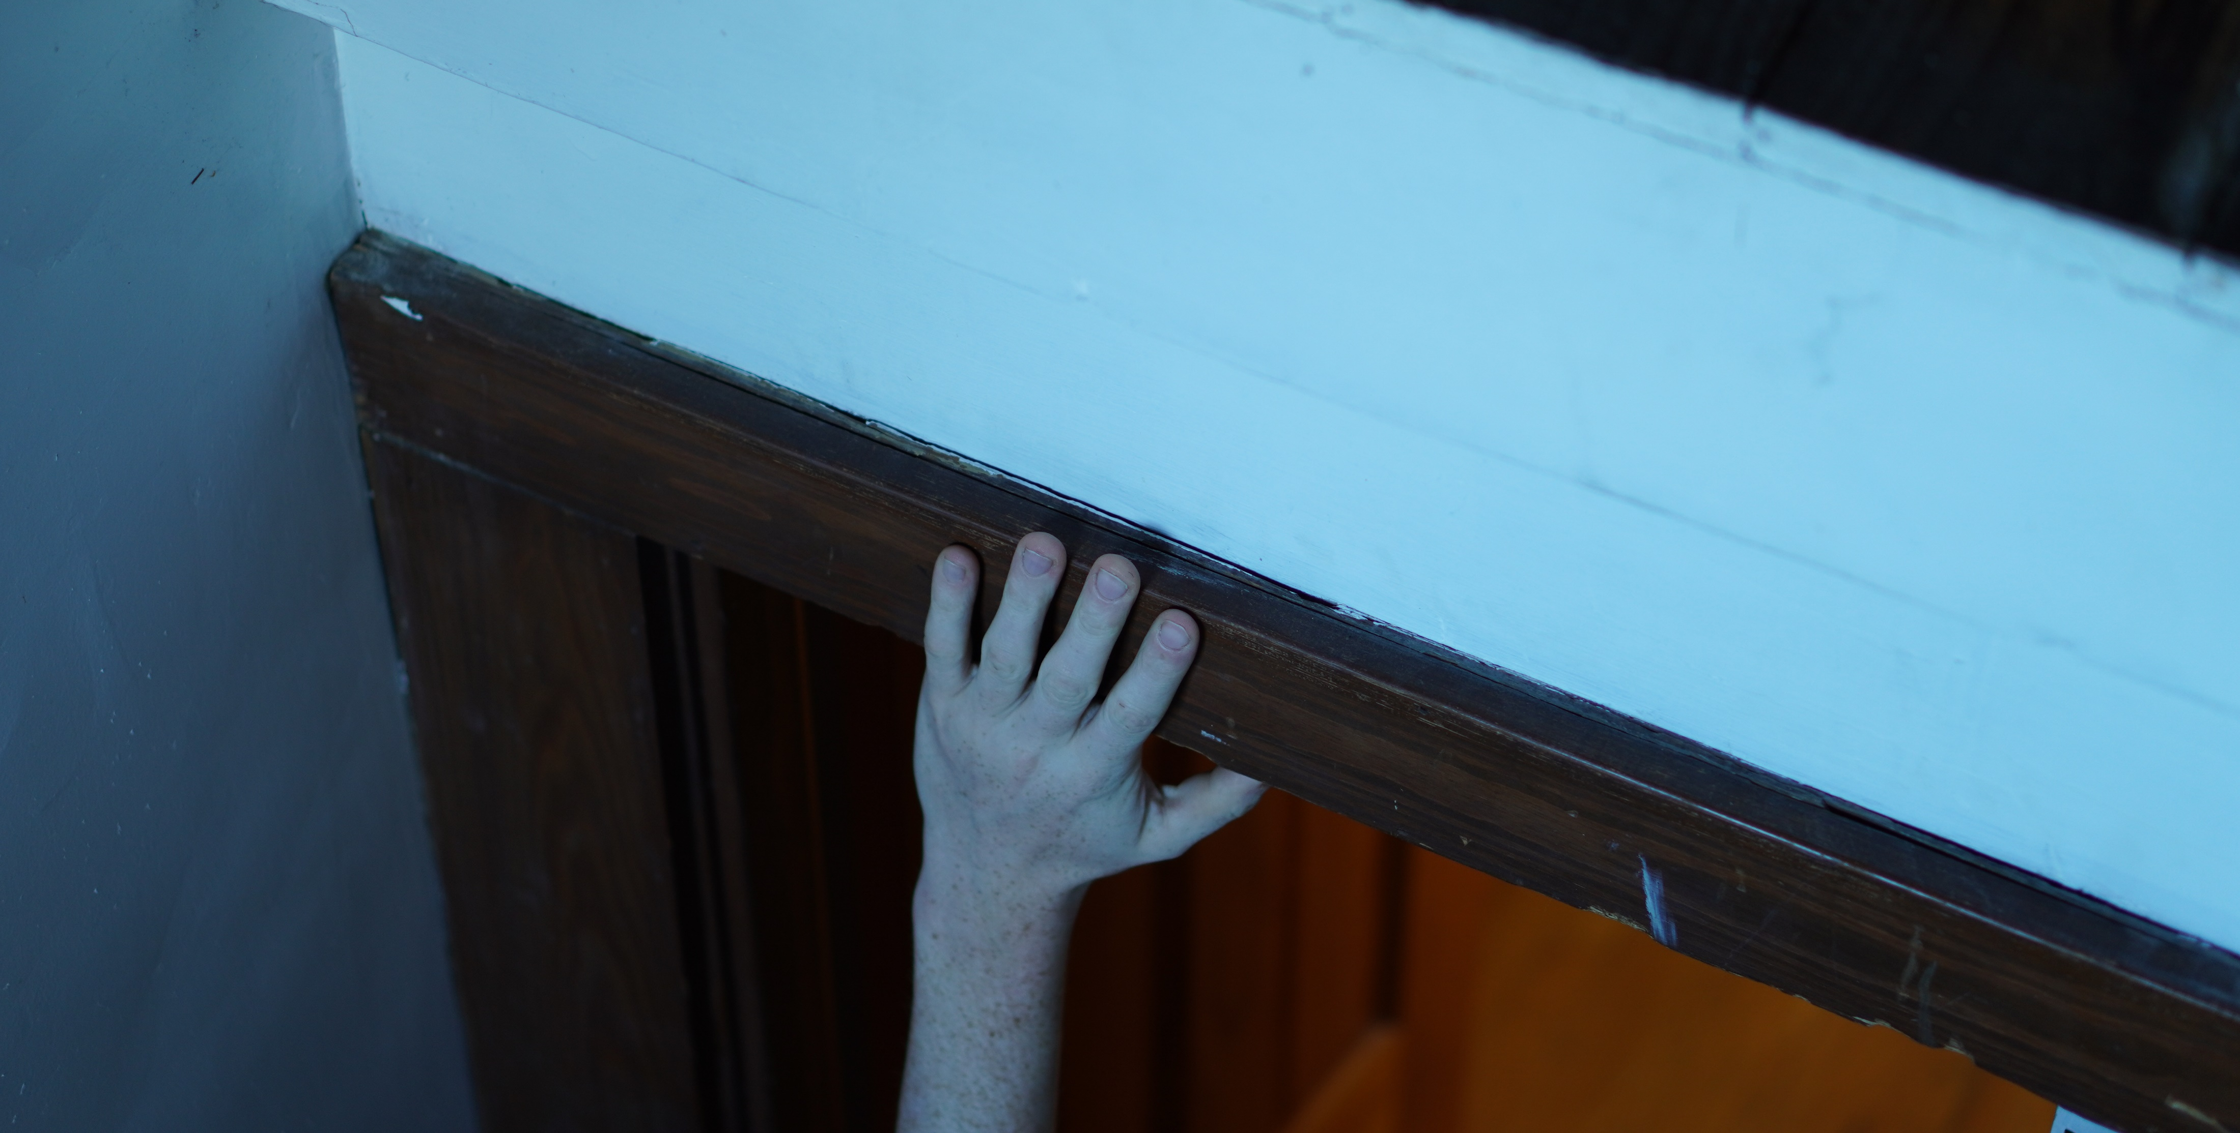
Camera Angles
Tracking shots
(to follow the movements of the character)
Roll shots
(I want to get the entire enclosure area around the character in frame, plus the roll gives it more of an emotional state.)
Dolly and Pedestal shots
(reveals objects and other props)
Pan shots and Stills (TBD)

Slide 4
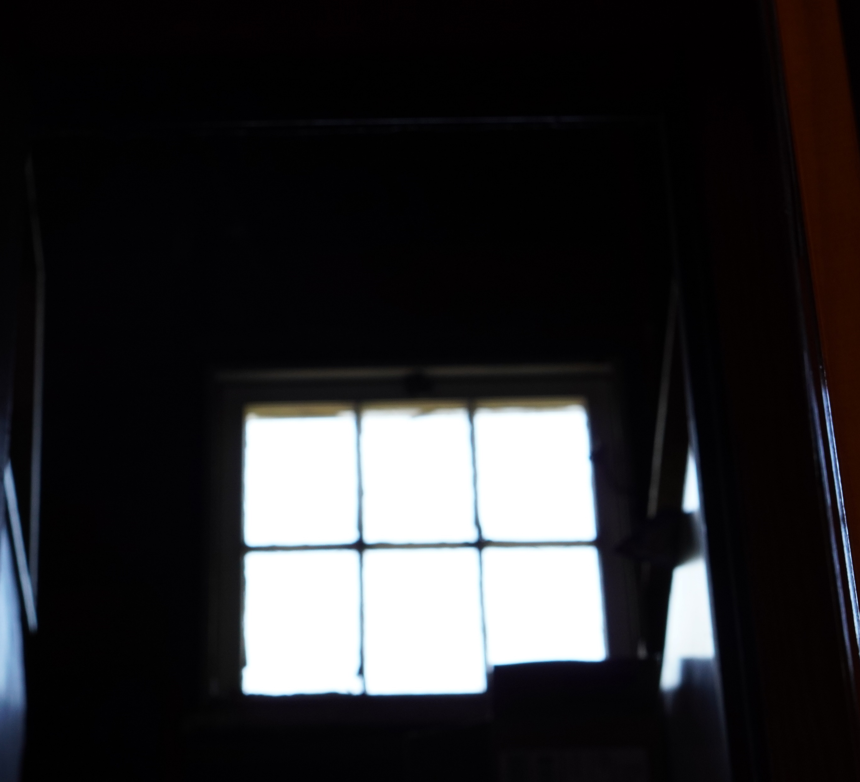
Lighting
I plan on using a lighting kit for some shots, but I want most of my shots to consist of as much natural light as possible. For example, this image I balanced the exposure enough so that enough natural light could enter the sensor. Also, if there’s a lamp or other object that emits light that is stuck to its environment, I will try to capture that as well.

Slide 5
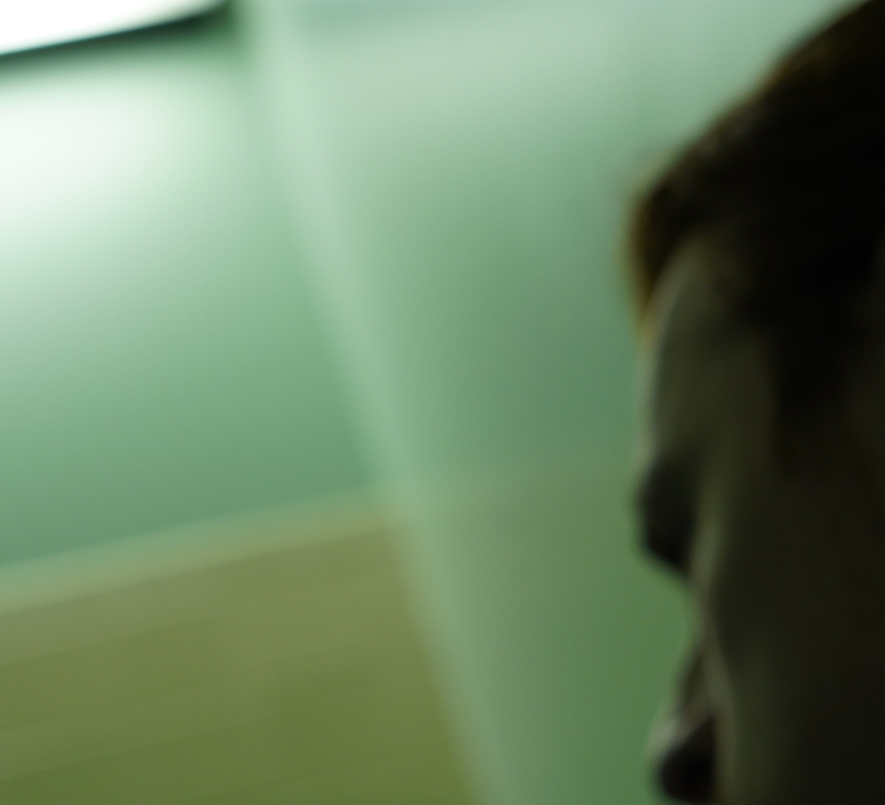
Character
The character will probably be me because I couldn’t find any actors. The character is someone that goes through a lot of turmoil and stress. Someone who is bound financially, kept in the loop by his family’s dysfunction, and ultimately wants to escape from a decrepit collapsing city like Erie.

Slide 6
Colors and Tone
I’ll be using mostly heavier colors to convey something that is pressing or inflicting within my shadows and midtones. Towards my highlights, I will obviously be using lighter colors while also applying that same feeling.

Slide 7
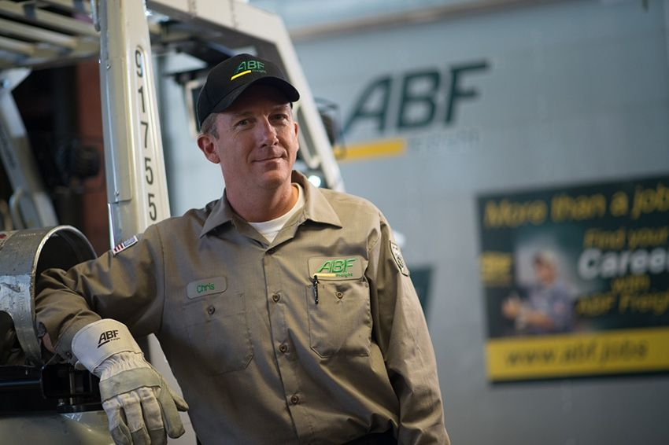
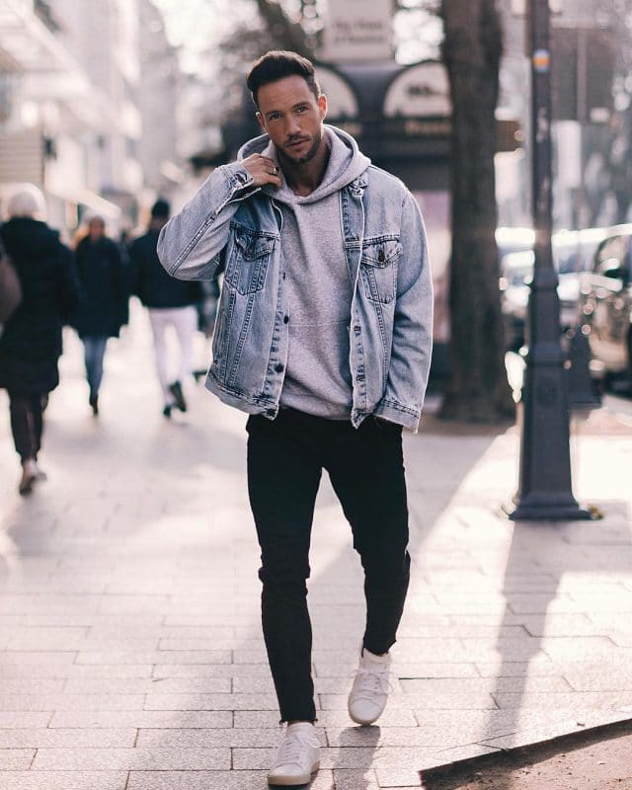
Costume Design
Might be looking at using street clothes or dress casual clothes, something that any guy my age would wear. I will also probably use a freight shirt (I wear for work) to invoke a hard days work.

